Slide 1
MACROECONOMIC DETERMINANTS OF EMIGRATION FROM UGANDA
MUHAME Alon
Msc. QE, 2017/2020
May , 2020

Slide 2
Outline
Introduction
Where are Uganda’s largest emigrant flows?
Literature Review- Theoretical & Empirical Approaches
Methodology, Model Specification, Estimation & Diagnosis
Results/findings and Conclusions
Policy recommendations & Further research
References
“He asked me, ‘Son of man, can these bones live?’” (Ezekiel 37:3)

Slide 3
Introduction
Globally, in 2017, there were around 258 million international migrants, approximately 3.4 per cent of the world population (UN DESA, 2017a)
Cross-border labour migration has become intense within the EAC countries (Odipo et al., 2015), owing to the Common Market Protocol (CMP) in 2015
In Uganda, emigration has existed within diverse social, political and economic contexts (IOM, 2015b), and has been driven by ;
Poverty , population growth, porosity of international borders
However, there has been recent upward trend of Ugandan emigrants to middle east and Asia (i.e., esp., GCC)

Slide 4
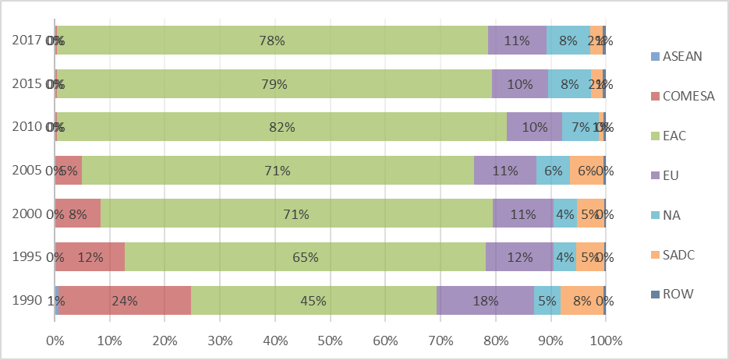

Major Destinations of Uganda’s Emigrants
EAC, COMESA, EU, SADC are major trading blocs where most Ugandans migrate internatioanally

Slide 5
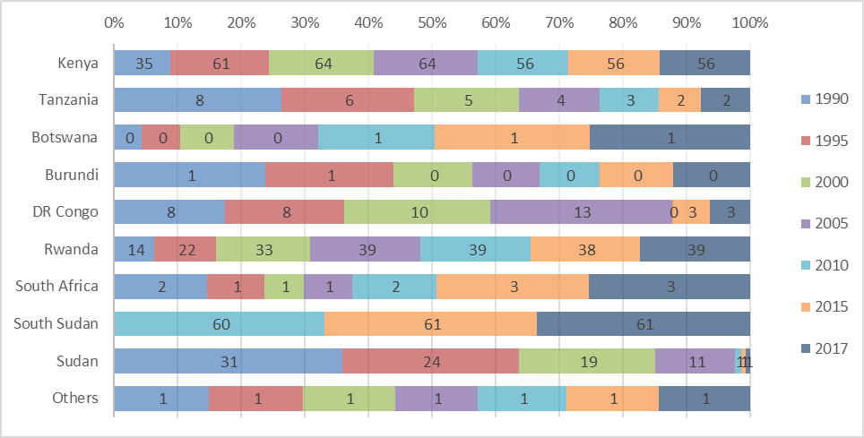
In Africa;
Kenya is a major destination of Ugandans in East Africa; - Rwanda & Tz come next , a new destination is SSD
Notes:
Kenya, Rwanda & Tanzania, Then Burundi and South Sudan;

Slide 6
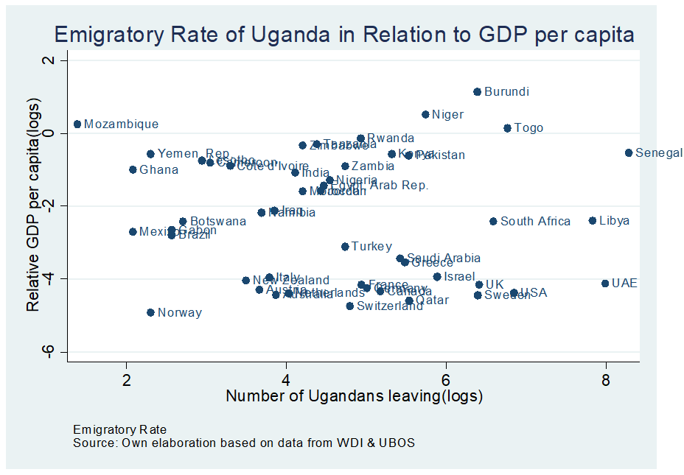
Ugandans tend to intnal move to countries with high economic growth reative to Uganda;

Slide 7
Problem statement
Emigration and immigration continue to provide States, societies and migrants with many opportunities IOM, (2017)
Main push factors for leaving Uganda are ; population growth; youth unemployment, which encourage Ugandans to search for job opportunities abroad, especially in the service sector (Muscoda, 2006, NPA, 2010).
Existing studies in other countries yield inconclusive findings on macroeconomic determinants of emigration (Ombaire, (2016), Nwajiuba, (2005), Jennissen, R. (2003), Mendoza (2006), Mayda (2010), Balderas and Greenwood, (2010), Ivan (2008), Lewer and Van den Berg (2008), Ullah, (2012))
Therefore, the study went ahead to determine the macroeconomic factors influencing emigration from Uganda

Slide 8
Research Objectives
The general objective of the study is to establish the key macroeconomic determinants behind the increased emigration of Ugandans.
The specific objectives of the study are:
To analyze the relationship between GDP per capita and emigration from Uganda.
To analyze the effects of Exchange Rate on the propensity to emigrate from Uganda
To examine the relationship between inflation rate and emigration

Slide 9
Hypothesis
There is no significant relationship between the emigration and GDP per capita in Uganda.
There is no significant relationship between the emigration and Bilateral Exchange rate in Uganda.
There is no significant relationship between emigration and Consumer price index in Uganda
Significance of the study;
Studies in Uganda have focused mainly on impact of remittances and migration on the household level (Mushomi et al, 2011).
With the Common Market Protocol and the common East African passport in use by Kenyans, Ugandans, and Tanzanians, and visa-free movement of persons within East Africa partner states occurring (Adepoju 2005). This will go a long way in policy design and handling migration issues so as to reap more from the East Africa Community in terms of more increased job opportunities, skill enhancement, innovation and remittances flows for Ugandans. This study will help shed more light on the macroeconomic factors of emigration from Uganda.

Slide 10
Emigrants and Immigrants Data / Meaning
The United Nations (1998) defines a migrant as “any person that changes his or her country of usual residence”
Emigration is usually defined as a change of usual residence to a different country
Countries employ a wide range of tools to record emigrants & immigrants;
population censuses,
population registers and registers of foreigners,
border statistics,
worker and residence permit
Notes:
Note :WB, Remittances fact books rely on Population census and registers and data used in the study is from border statistics

Slide 11
Theories of Migration;
Literature Review – Theoretical Approach
Classical Economics theory of migration- views migration as intention for maximization of individuals’ income.
Lee’s Push-Pull Theory – Push factors such e.g., poverty
NELM – Intnl migration takes place not only due to situations in the labor market but also other markets like unemployment insurance markets or capital markets
Dual labor market theory – Labor m’kt structural changes cause migration
World systems theory – Focus is on Supply side
Networks Concepts Theory – e.g Kinships, friendships
“So I prophesied as he commanded me, and breath entered them; they came to life and stood up on their feet - a vast army.”
(Ezekiel 37:10)

Slide 12
Literature Review – Empirical Approach

Slide 13
Methodology, Model Specification, Estimation, Data & Diagnosis
GRAVITY MODEL: EMPIRICAL SPECIFICATION

Slide 14
DATA

Slide 15
ESTIMATION RESULTS

Slide 16
Results and Discussions
MAIN FINDINGS:

Slide 17
ROBUSTNESS CHECKS

Slide 18
Policy Implications, Recommendations and Further Research

Slide 20
THANK YOU for your attention !!

